Slide 1

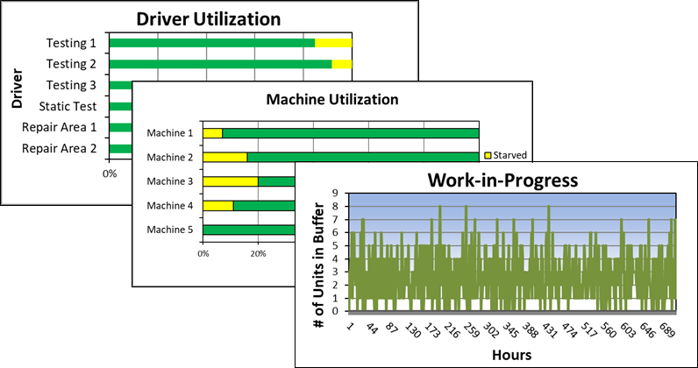
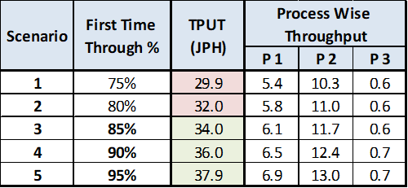

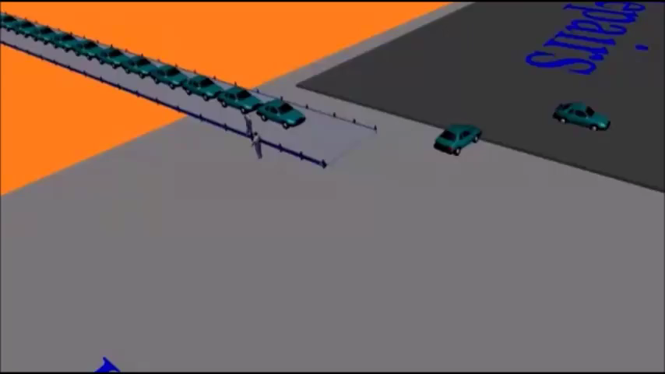
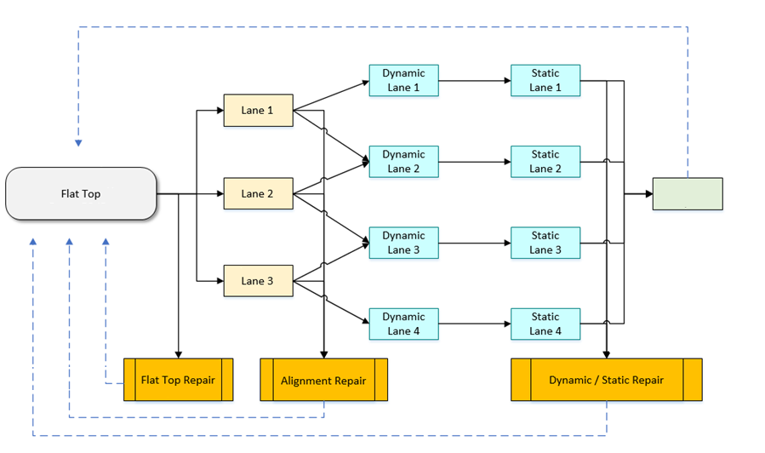
Simulation of an End-of-Line Testing Area for a Leading Vehicle Manufacturer
Automobile Industry
AutoMOD
End of Line
Driver Utilization
Capex Study
A leading global automotive company wanted to right-size the number of drivers required for maneuvering vehicles in the End-of-Line section of its automobile production ensuring the desired target is met.
Client’s Challenge
Identify and alleviate bottlenecks in the system
Recommend ideal number of car drivers, process stations and parking spaces in the End-of-Line section
Analyze the impact of repair rates on system throughput
<Video>
Findings & Recommendations
The system was able to produce just 65% of its target production.
We found that the number of calibration test drivers were the first constraint in the system
Addition of 2 more drivers improved the throughput by 30%
The number of body repair stations were the second constraint in the system
Improving the cycle time by 50% by addition of labor ensured the throughput is met
A First-time-through sensitivity test showed that a minimum of 75% vehicles should clear the inspection test to meet target production
PMI’s Approach
The station cycle times were statistically modeled based on real-time data from client
The detailed process was modeled in Simul8
The queue sizes, driver and equipment utilizations were studied while varying first-time-through rates

