Slide 1
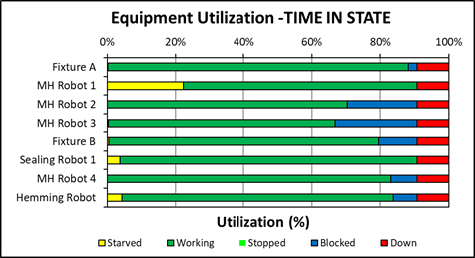
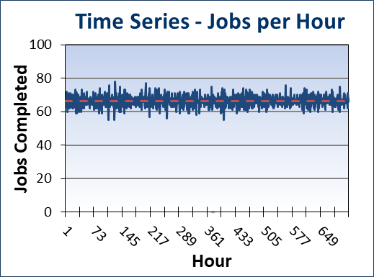
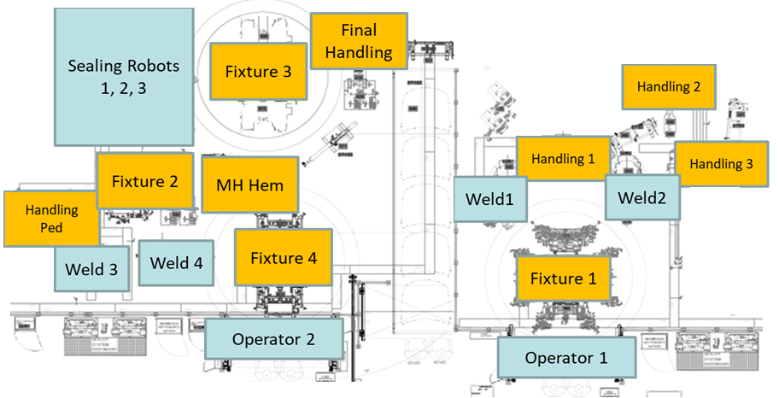
Simulation of an Automated Closure line for a Leading Supplier
Automobile Industry
Tecnomatix Plant Simulation
Work Cell Simulation
Bottleneck Analysis
Downtime Analysis
A leading line builder designed a new body shop line for its client in the automobile industry and wanted to check the feasibility of its proposed design and identify minimum buffer sizes to achieve target production
Client’s Challenge
Check feasibility and validate the proposal
Identify and alleviate bottlenecks in the system
Identify minimum buffer sizes required to achieve target production
<Video>
Findings & Recommendations
The system was operating only at 85% of its designed capacity
We were able to identify the first bottleneck to be the buffer between an assembly and an inspection station
The minimum buffer requirement was suggested through buffer sensitivity analysis
The throughput loss due to selecting a smaller buffer was demonstrated
The second bottleneck of the system was the operating sequence of a material handling robot
The cycle time of the handling robot needed to be reduced or the operating sequence had to be modified
PMI’s Approach
The detailed process was modeled in Tecnomatix Plant Simulation
The operating sequences and downtimes from the client were provided through an Excel interface to the simulation
The buffer variation, throughput and time-in-state graphs were recorded and studied

