Slide 1
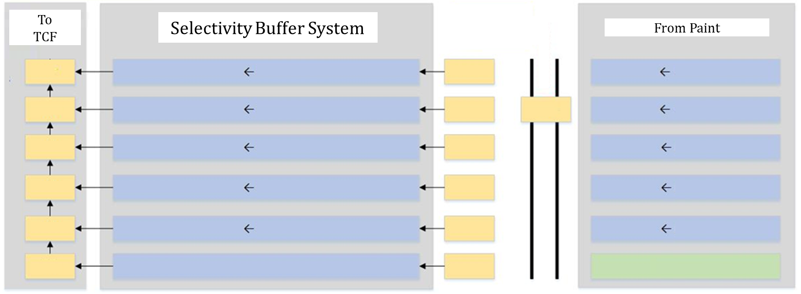
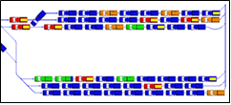
Simulation of a Sequencing Buffer for a Leading Vehicle Manufacturer
Automobile Industry
Simul8
Sequence Optimization
Feasibility Study
Logic Optimization
A leading global automotive company wanted to improve its operations by studying the feasibility of a buffer system in supporting the required sequencing constraints at Final Assembly. Sequencing is one of the most influential production planning processes that helps produce multiple models/ variants on a shared manufacturing setup efficiently
Client’s Challenge
Check feasibility of a buffer system to lift sequencing constraints
Identify the number of violations in sequence and recommend ways to minimize the same
<Video>
Findings & Recommendations
We found that around 300 vehicles / day violated the sequence.
Three main parameters affecting the violations were identified and studied separately
Recommended revision in model mix so that the number of violations is reduced without affecting the desired product flexibility
Optimum size of the sequencing buffer system was identified to eliminate violations
+ Graph in the video ?
PMI’s Approach
We modeled the detailed sequencing setup in Simul8
System throughput, time-in-state graphs for transfers, paint and final shops, buffer variations and the exit sequence were tracked
Analysis was carried out to find the main reasons for sequence violations
Selectivity Storage Buffer Layout

