Slide 1

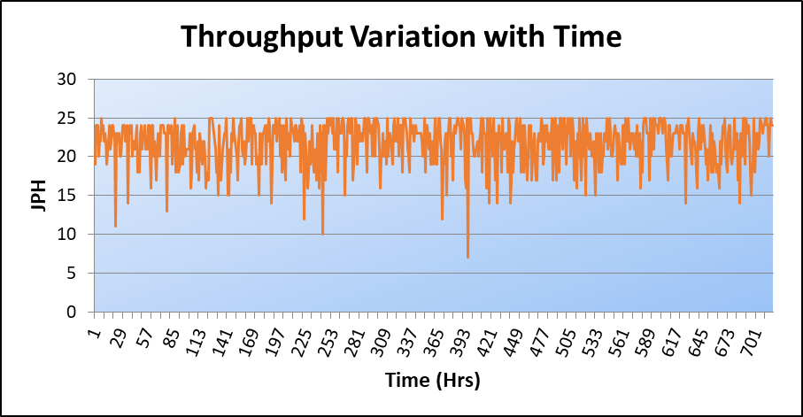
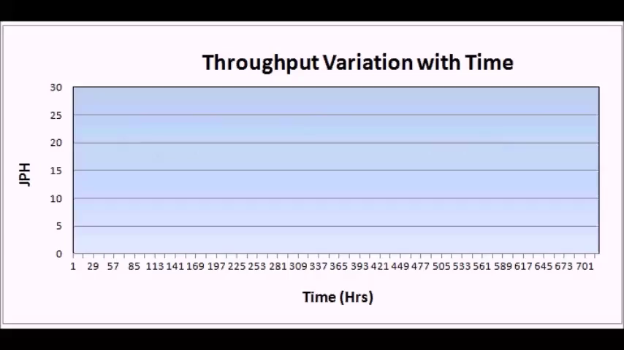


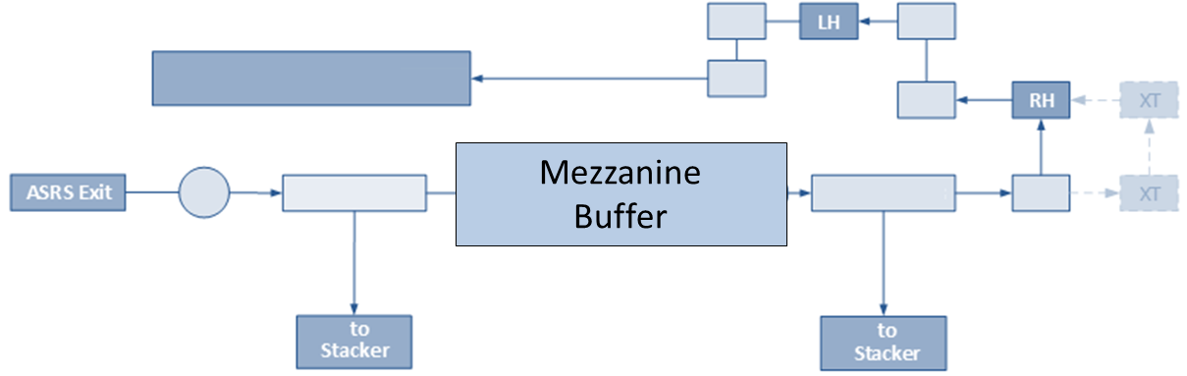
Simulation of a Door Assembly Line for a Leading Vehicle Manufacturer
Automobile Industry
AutoMOD
Bottleneck Analysis
Buffer Analysis
Carrier Analysis
A leading global automotive company wanted to improve its operations, setup optimum number of carriers in its Door assembly area to meet its increased production target.
Client’s Challenge
Identify and alleviate bottlenecks in the system
Recommend ideal number of door hangers, buffer sizes and other operational changes to achieve target production
<Video>
Findings & Recommendations
We found that there was loss in production due to downtimes, particularly whenever a specific model type arrived
Recommended addition of a mezzanine buffer just before an unloading station which proved to eliminate blockages caused during downtimes
Due to a routing constraint, a vehicle required 3 minutes of travel time which lead to loss in throughput
Recommended two more cross transfers to be added in the system before the unloading station
PMI’s Approach
We modeled the detailed door lines and main lines in AutoMOD
System throughput, time-in-state graphs, number of vehicles in the system were tracked
Recommended Layout with Mezzanine Buffer

