Slide 1

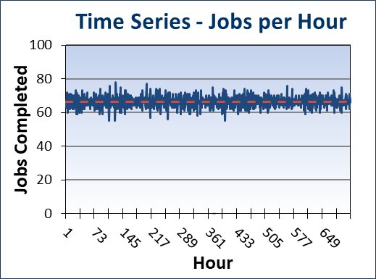
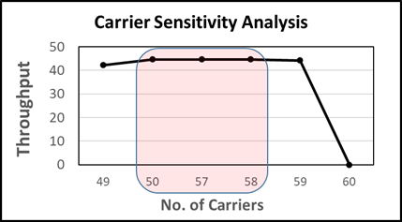
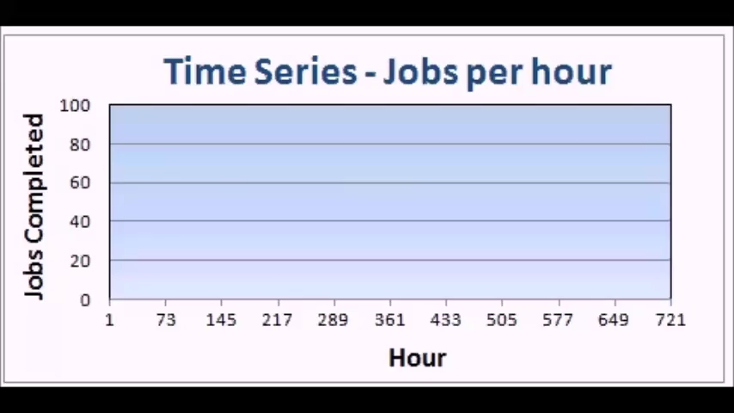


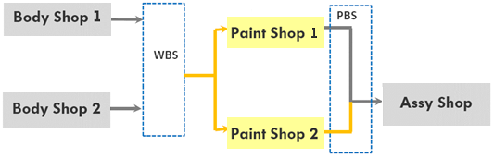
Simulation of an Automobile Plant for a Leading Vehicle Manufacturer
Automobile Industry
AutoMOD
Material Flow Analysis
Congestion Analysis
Carrier Analysis
A leading global automotive company planned to add new body and paint shops in the facility to ramp up its production. They wanted to study the behavior of the individually designed systems as a whole and define routing rules, identify buffer sizes between the shops to achieve its production target
Client’s Challenge
Identify optimum buffer requirement and carrier counts between Body and Paint, Paint and Final shops
Recommend conveyor layout with required number of lanes and their parameters to improve routing
Optimize rules between body shop and paint shop to minimize purge operations in paint shop spray booth
Optimize rules between paint shop and final shop to rearrange mixed up units to their original sequence
<Video>
Findings & Recommendations
We found that the main bottleneck in the system to be the chassis line in the assembly shop with the design buffer system and carrier counts.
Increasing the door loop conveyor capacity by 20 units improved the throughput
Using the recommended number of carriers and the conveyor layout for WBS and PBS helped achieve the target throughput
+ Graph in the video
PMI’s Approach
We carried out static analysis, 2D and 3D simulation to study in detail :
Body Shop, Paint Shop and Final Assembly separately
Total Plant combining each shop and intermediate vehicle handling and storing conveyors (Body-In-White Storage/ BIW and Painted Body Storage / PBS)
Total Plant Layout

