Slide 1
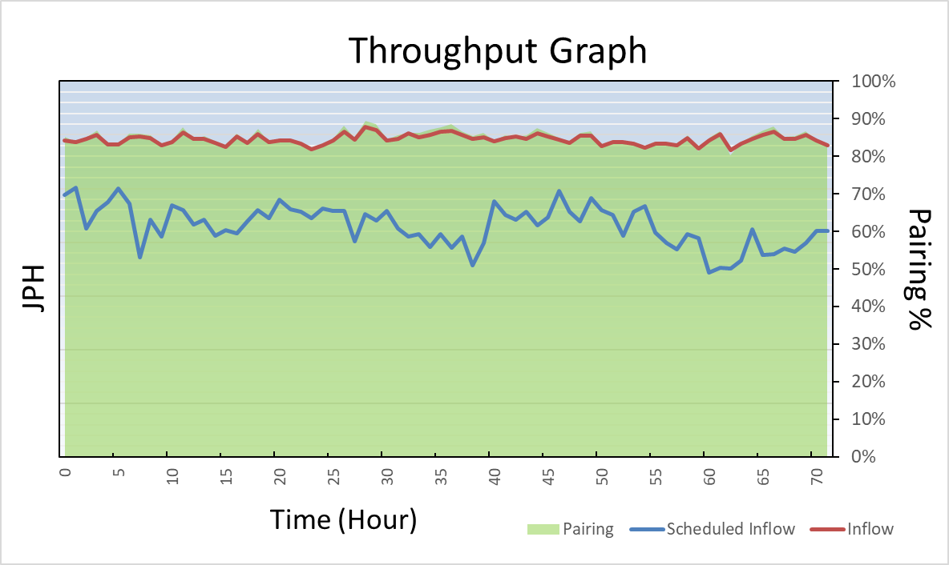
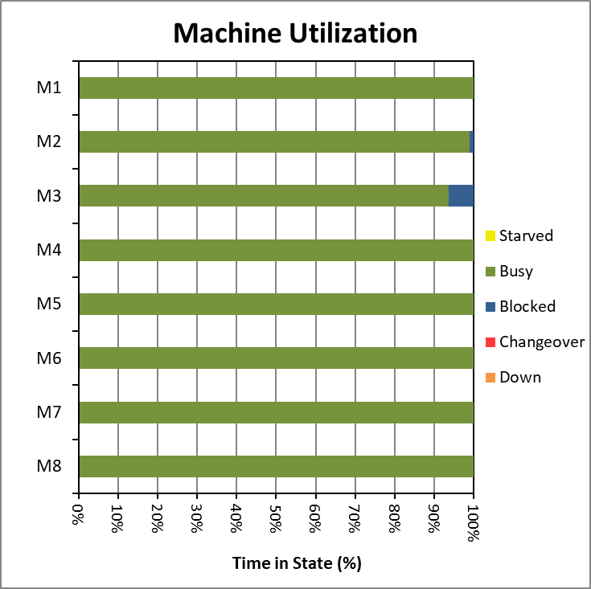
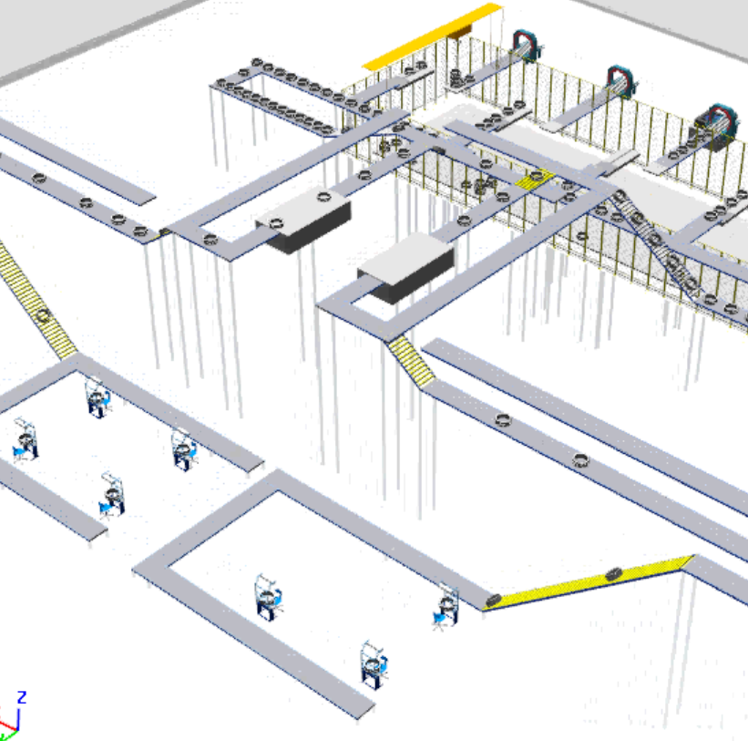
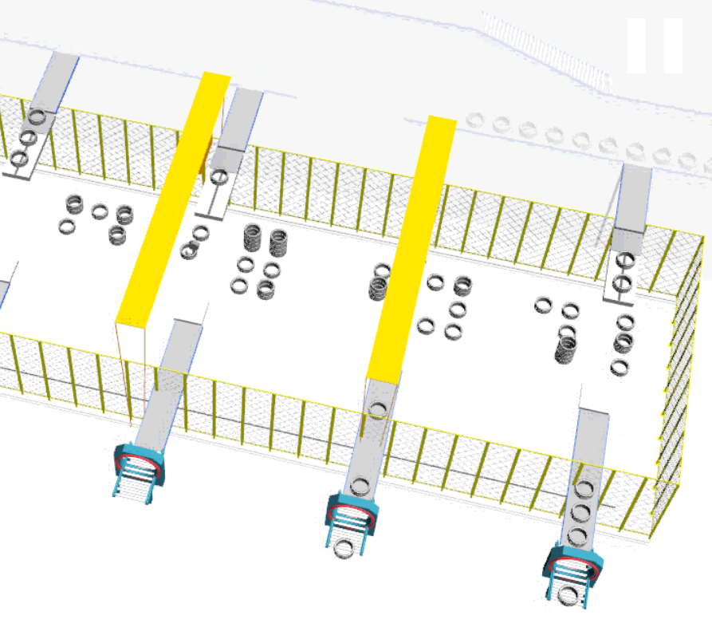
Simulation of a Tyre Factory for a Leading Producer
Back to Tyre Industry
Back
Tyre Industry
Tecnomatix Plant Simulation
Bottleneck Analysis
Sequence Optimization
Capex Study
One of India’s leading tyre manufacturers expanded its existing facility to double its production rate.
New EMS (Electro Monorail System) loops, ASRS (Automated Storage & Retrieval System) facility, conveyor systems and gantry cranes were set up to streamline flow and automate handling of tyres.
Client’s Challenge
Identify capacity of existing system
Find out reasons for production loss
Investigate excessive inventory build-up
Define optimal strategies for efficient operation
<Video>
Findings & Recommendations
Unloading stations of EMS Loop was the bottleneck
Using additional station improved the performance
Operating pattern of EMS carriers was blocking the tyre supply from building machines
Using 2 tyres per EMS carrier improved the capacity by 25% and halved the carrier requirement
ASRS handling partial loads due to unavailability of two back-to-back tyres of same type
Ensuring that no order is left unattended at unloading station ensured the partial loads can be processed without affecting ASRS performance
Inspection station and conveyor flaps led to mixing of tyres causing gantry to wait for back-to-back tyres of same type
Optimized working of conveyor flaps and proposed new buffer near inspection to send out similar tyres together
PMI’s Approach
We carried out static analysis, 2D and 3D simulation to study in detail:
EMS Loop with loading and unloading stations along with operating logics
ASRS, inlet and exit stations with 7000 tyre capacity
Gantry system of 1500 sq. meters area and 6000 tyre capacity
Conveyor System
Gantry System

